Slide 1
14th Annual Biotechnology Entrepreneurship Boot Camp
Sunday June 3rd^{th} & Monday June 4th

Slide 2
Building and working with the board

Slide 3
Better boards make better companies

Slide 4
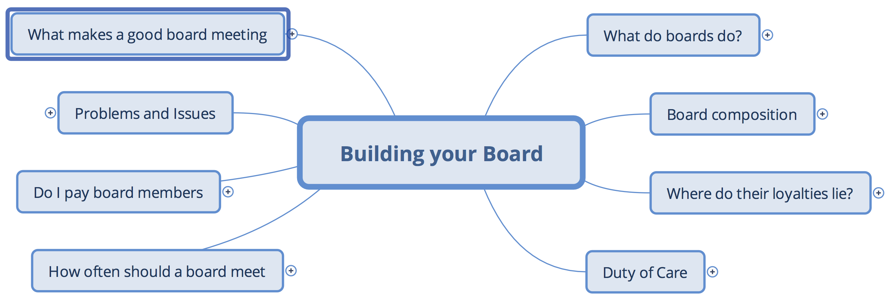
Building your Board

Slide 5
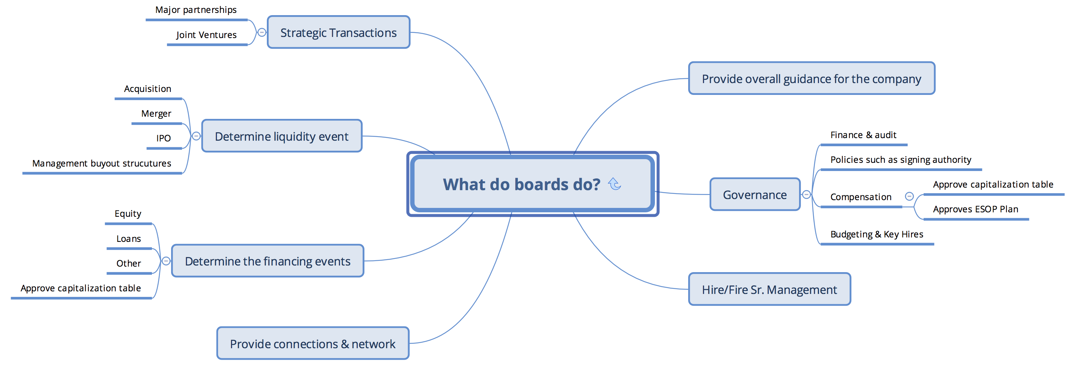
What do boards do

Slide 6
Board composition

Slide 7
Where do loyalties lie

Slide 8
Duty of care

Slide 9
How often should a board meet

Slide 10
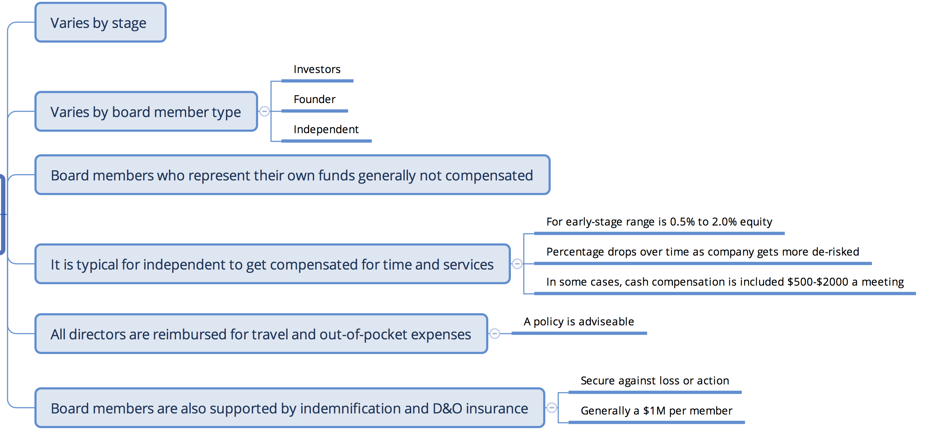
Do I pay board members

Slide 11
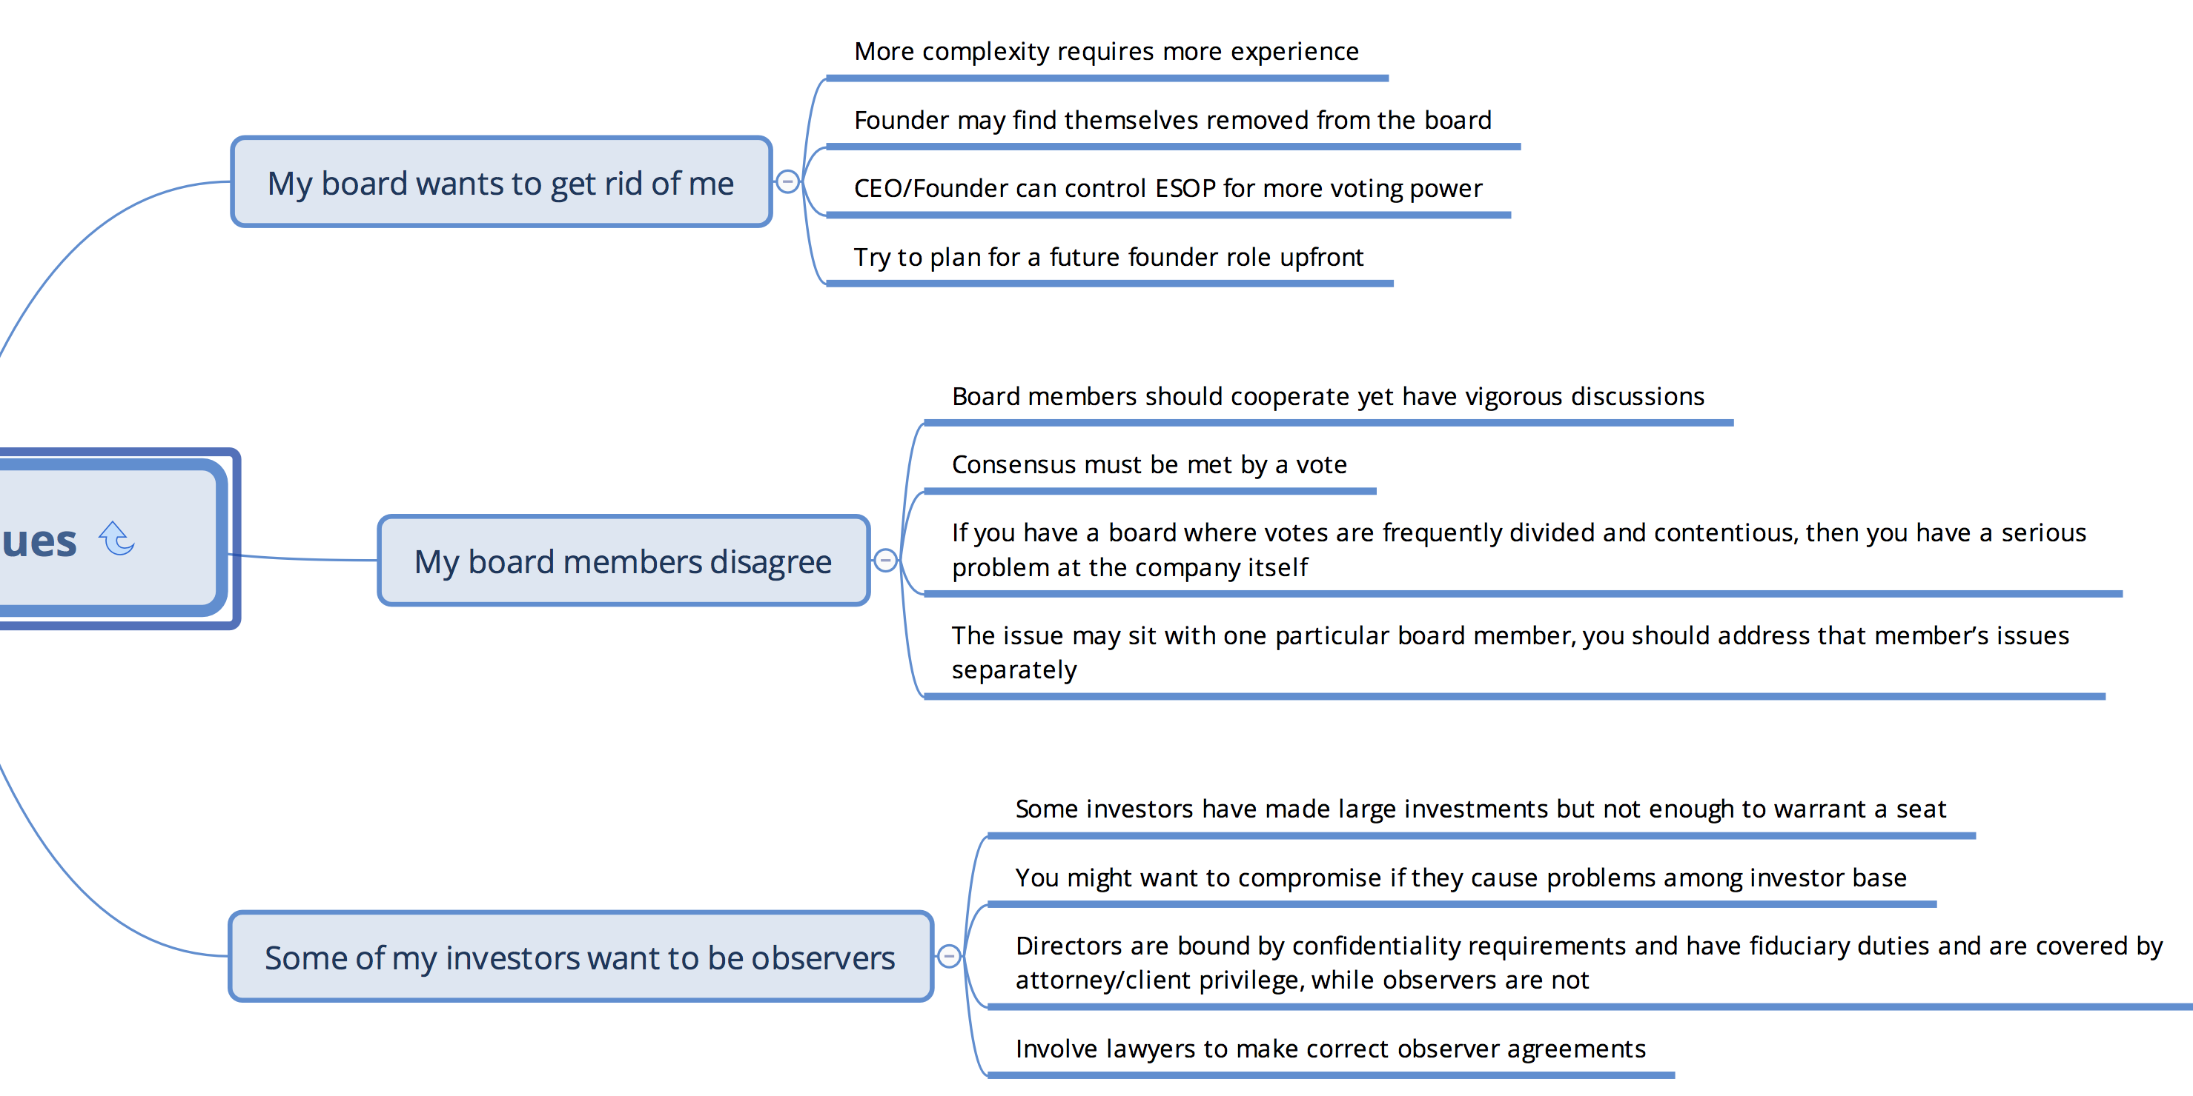
Problems and issues

Slide 12
What makes a good board meeting

Slide 13
“The ability to make good decisions regarding people represents one of the last reliable sources of competitive advantage since very few organization are very good at it”
-Peter Drucker, Business Guru
BIO Entrepreneurship Boot Camp

Slide 14
Who’s dealing with this issue now
Survey of Our Audience Today
Who are entrepreneurs here that have an early-stage company or are forming one?
How many have established a board?
How many of the directors are outside of management?
How many directors are friends or loyal to the founder/CEO?

Slide 15
Who should be on the team
Seasoned CEO’s or Executives with Successful Entrepreneurial Experience
(Everybody needs a coach)
Persons with Capital Raising Experience and Current Contacts
Executives from Your Company’s Technology Area
Venture Capitalists are Coming Soon
Experienced Board Members From Your Industry

